Slide 1
Well, the cluster was running really fast today.
First results of the GFS data follows

Slide 2
Bot model priors
Ne current and historic 1-100,000
Bot Ne 1-2000
T bot end 1-30
T pre-bot 15-100
Constant Pop model
Ne 1-100,000
T – 1-100

Slide 3
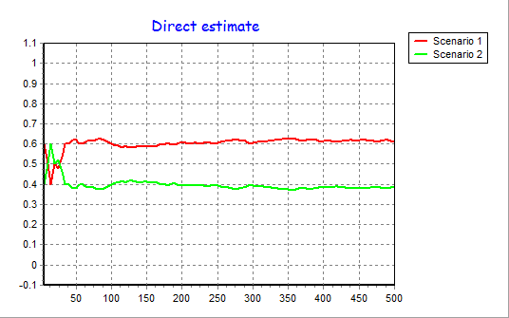
Scenario 1 is the bottleneck model

Slide 4
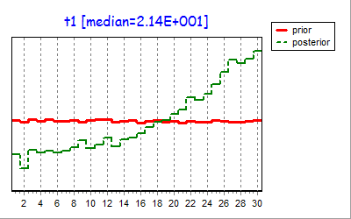
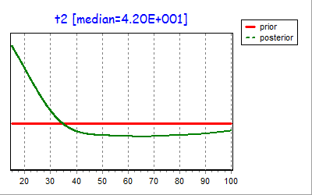
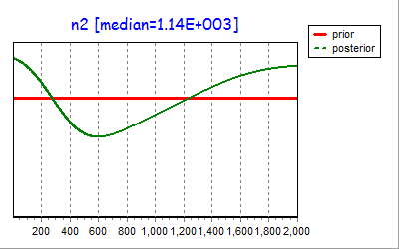
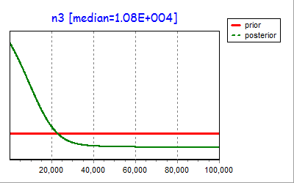
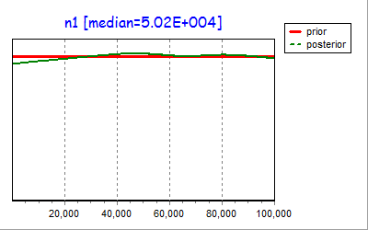
Posteriors for the bot model (scenario 1)

Slide 5
Ok, gotta run. Will be on the road the rest of the day.- talk soon.

